Slide 1
INFORMATION Security
MAN IN THE MIDDLE ATTACK

Slide 2
Man-in-the-Middle Attack
Step-by-Step Guide
01
Enable Mobile Hotspot:
Share your mobile's hotspot. Check if any device connects to the hotspot. If it does, proceed.
02
Connect Linux System.
Open your Linux system and connect it to your mobile hotspot.
03
Launch Ettercap.
Open the Linux search bar and type 'ettercap-pkexec' Launch Ettercap.

Slide 3
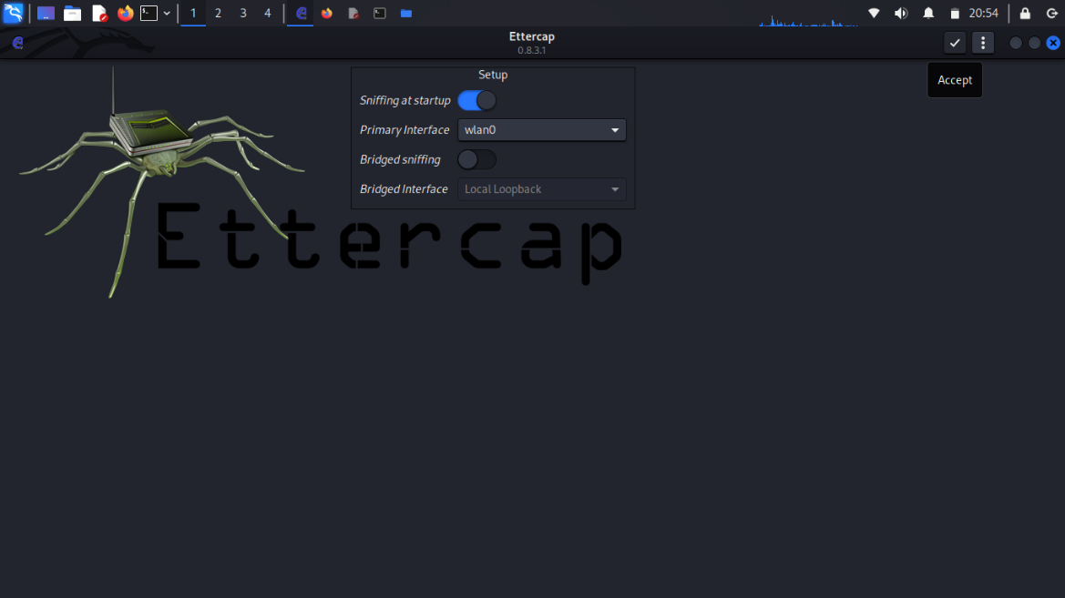
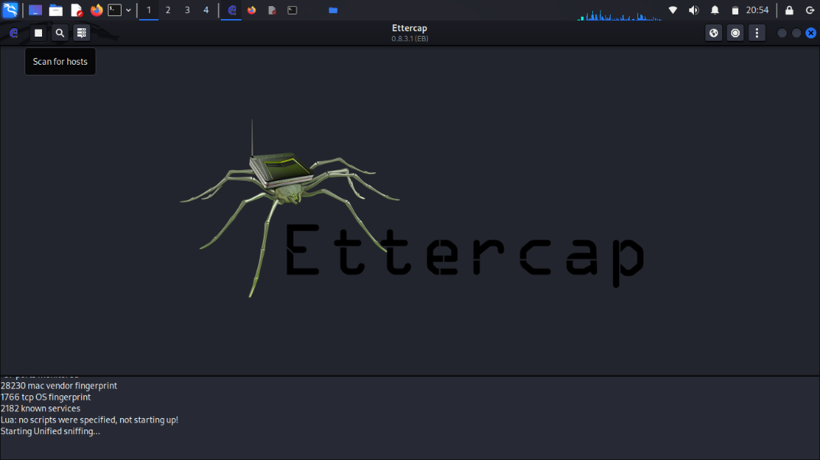
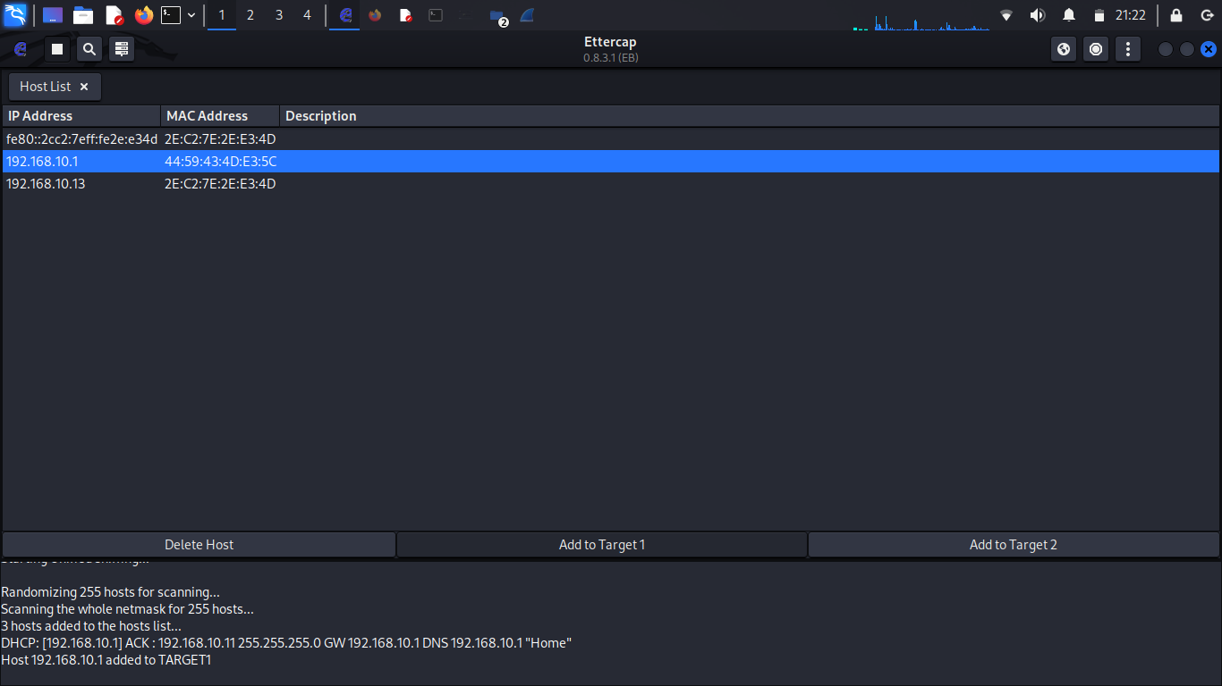

Once it's open, click on the Search icon.
There will be another icon labeled Host List. Click on it to view all devices connected to the hotspot.

Slide 4
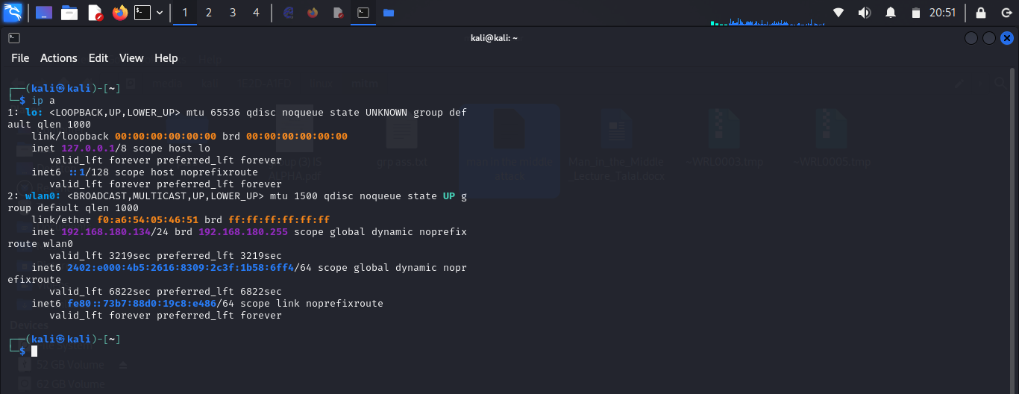

04
Identify Connected Devices
Ensure that your mobile hotspot is active and connected to multiple devices, including your PC. Open the Linux Root Terminal and type the command 'ip a'. This command will show the IP address of your PC that is connected to the hotspot.
Man-in-the-Middle Attack

Slide 5
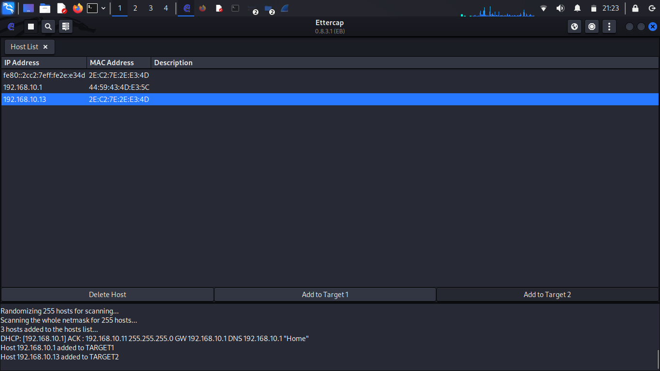
05
06
Check Hotspot Settings
In your mobile hotspot settings, confirm the devices connected to the network.
Set Up Ettercap Targets:
Go back to the open Ettercap tool. Once the Host List is visible:
- Under Target 1, select the IP address of the device you want to attack.
- Under Target 2, select your Linux PC’s IP address (found using the 'ifconfig' command in the Root Terminal.

Slide 6
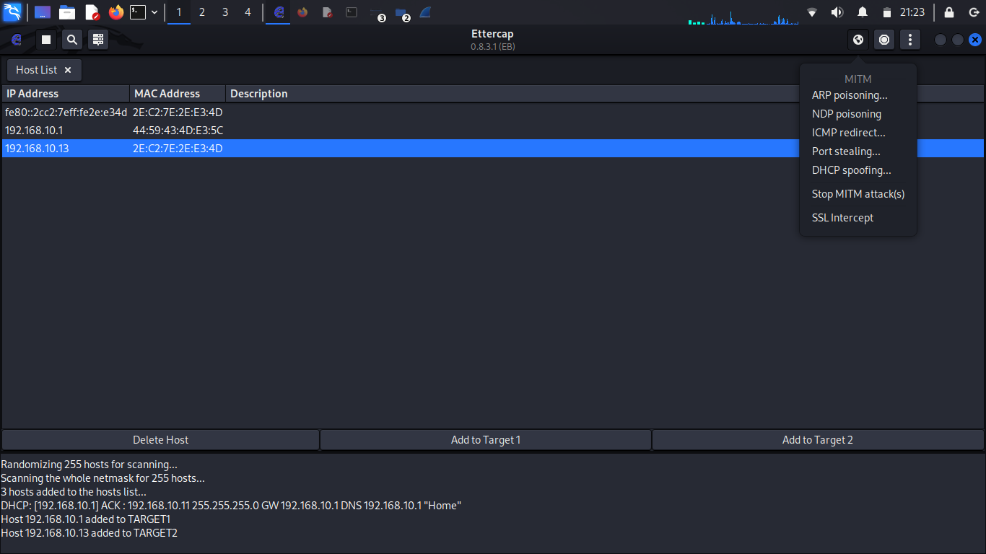
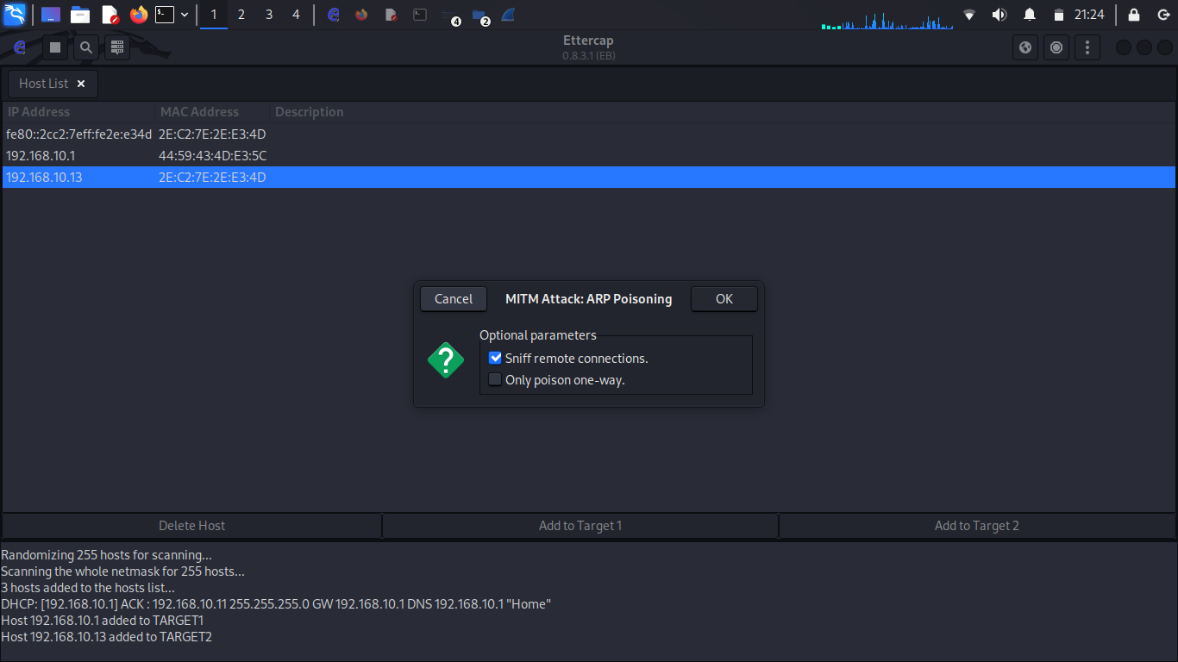
07
Launch ARP Poisoning:
Click the Globe icon in Ettercap. Choose ARP Poisoning (this is the primary method for MITM attacks).

Slide 7
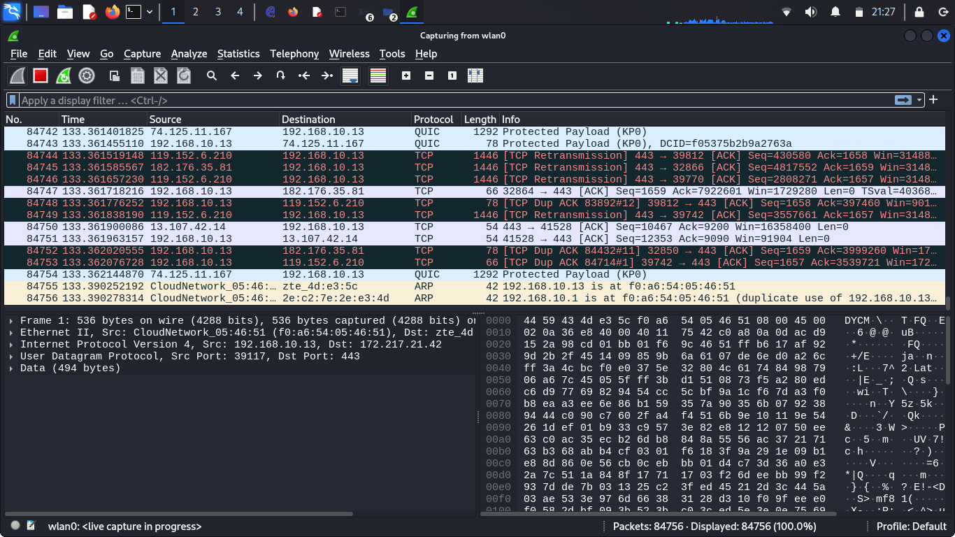
08
09
Launch Wireshark.
Search for Wireshark in the Linux tools menu and open it. Select the interface wlan0 (wireless network interface). Click the blue shark fin icon under the 'File' menu to start capturing traffic.
Monitor Victim's Activity.

Slide 8
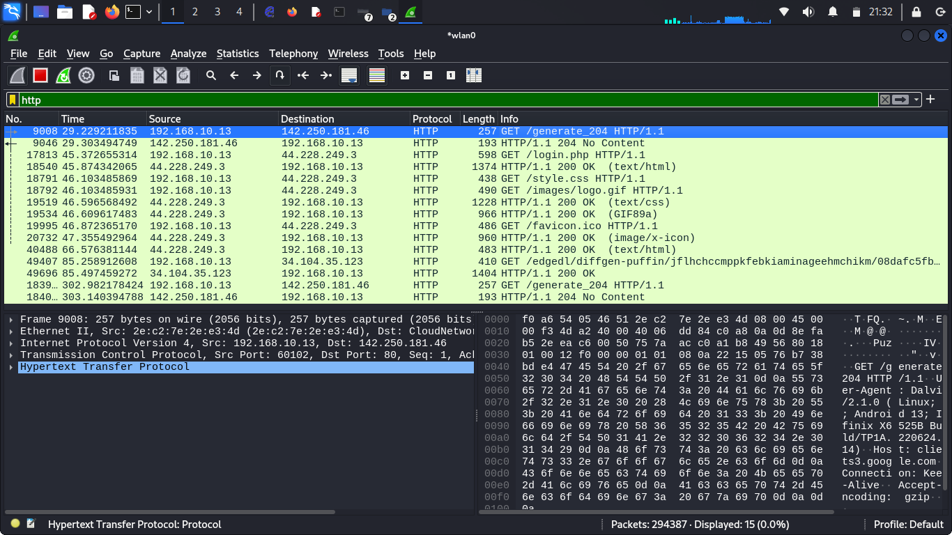
10
Capture HTTP Credentials.
If the victim goes in to any unsecured (HTTP) website, you can spy. In Wireshark, find the filter bar and type: 'http’ . Press Enter to filter requests. The list below will show the sites on HTTP connections.

Slide 9
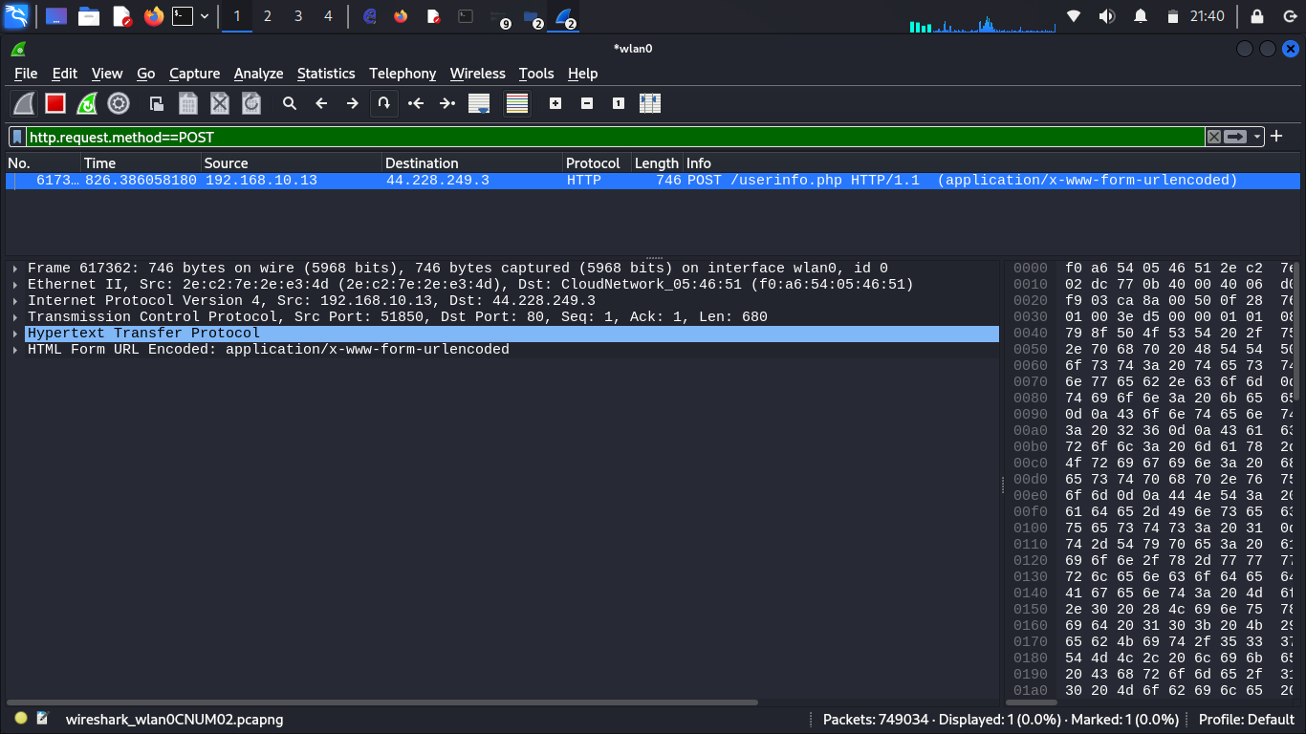
11
Capture HTTP Credentials
If the victim logs in to any unsecured (HTTP) website, you can capture their credentials. In the filterbar and type: 'http.request.method==POST'. Press Enter to filter login requests. The list below will show the sites the victim logged into on HTTP connections.

Slide 10
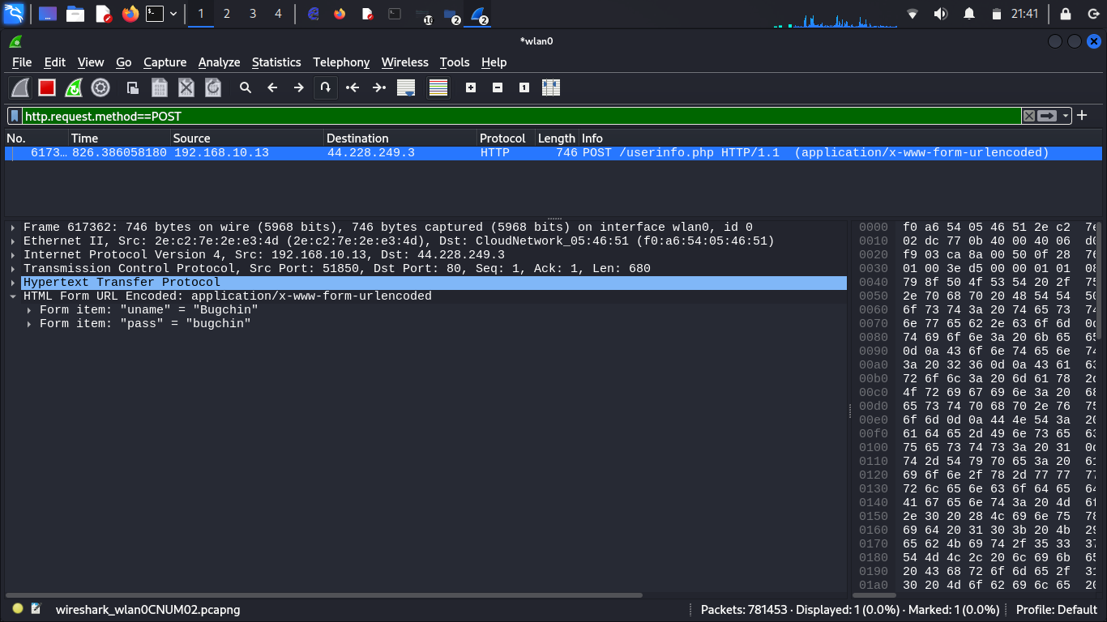
12
Extract Usernames and Passwords
Click on any listed site. If you’re unsure what to do, scroll to the last line of the HTTP request packet. You should find the username and password there.

Slide 11
PRESENTATION:
MAN IN THE MIDDLE ATTACK
GROUP MEMBERS:
TALAL NAFEES 19
MUNEEB NASIR 10
MUHAMMAD IRTISAM 06
MUHAMMAD UMER 05.

